Slide 1
FOXSI-2 update
2014 jan 7

Slide 2
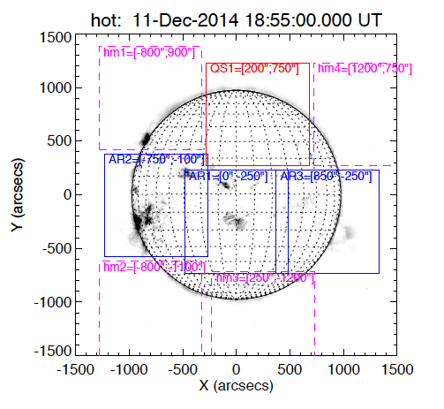
Pointing
Sequence (20-100 sec on each):
AR1
AR2
AR3
QS1
QS1 (shutter in)
AR1 (shutter in)

Slide 3
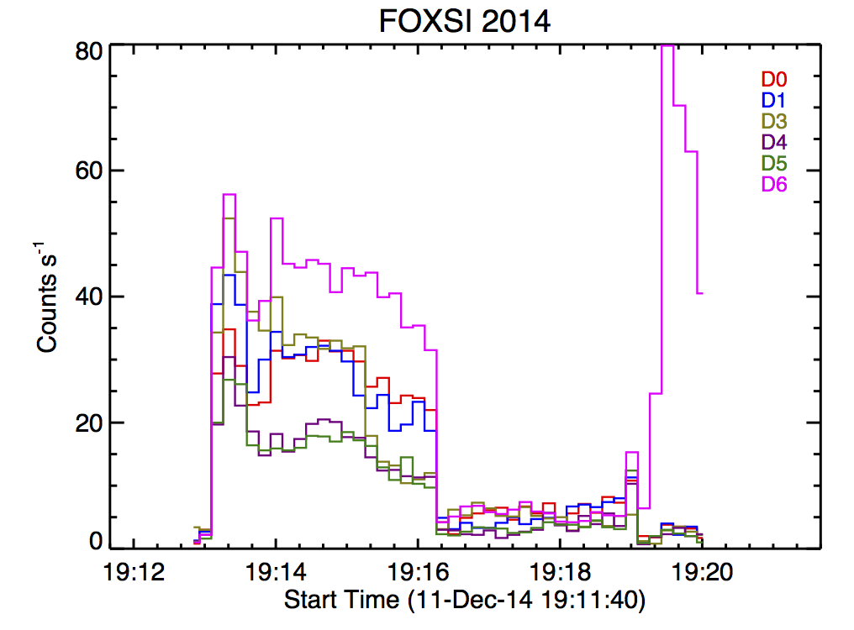
Time profile
RHESSI
Noise at shutter motion
AR1
AR2
AR3
QS
AR1

Slide 4
Target 1 (linear)

Slide 5
Target 1 (log)

Slide 6
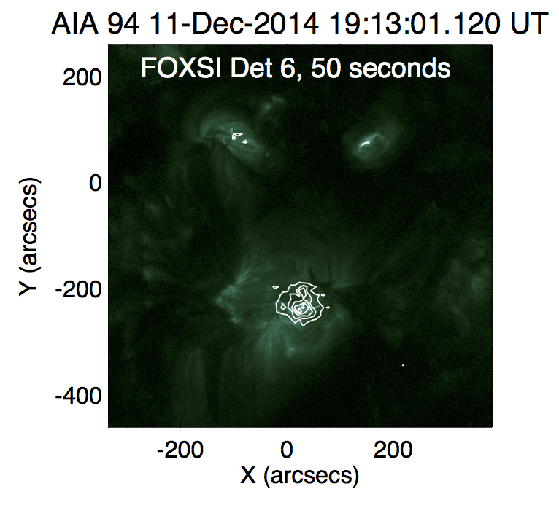
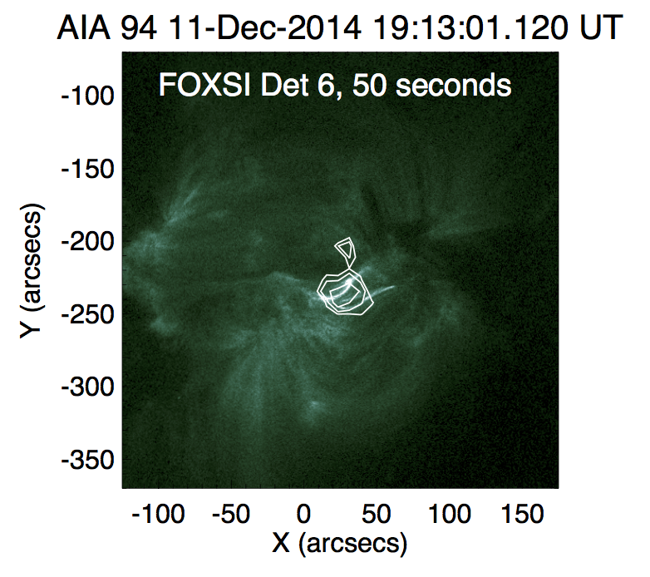
AR1, with AIA 94A
Sources are lined up by eye.
Note the angry monkey face.

Slide 7
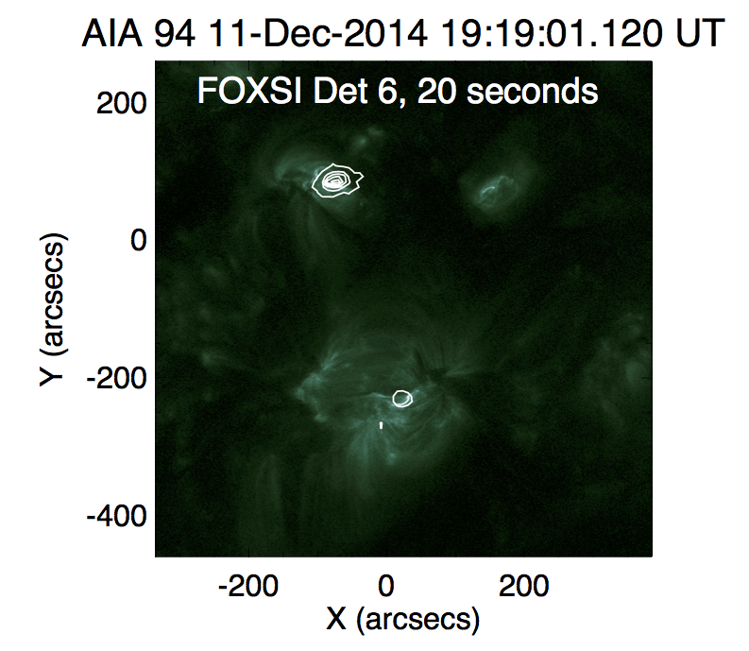
Last target, with AIA 94

Slide 8
Decaying limb flare and NuSTAR/FOXSI observations
NuSTAR

Slide 9
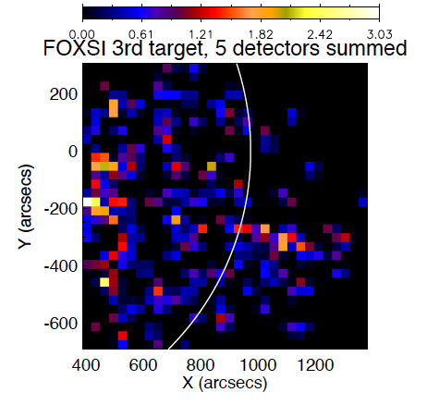
Does FOXSI also see it?
Hint of something at the limb, but not all detectors agree.
Flux on the disk? Maybe. (But be careful about ghost rays…)

Slide 10
Spectra
Det 1 weird

